Slide 1
RAU Operating Systems 2015
Lab #7

Slide 2
Hybrid Thread Synchronization Constructs
Hybrid locks are constructed by using User-Mode and Kernel-Mode constructs.
Hybrid constructs provide the performance benefit of the primitive user-mode constructs when there is no thread contention.
Hybrid constructs use the primitive kernel-mode constructs to provide the benefit of not spinning (wasting CPU time) when multiple threads are contending for the construct at the same time.
Today’s Lab work will cover:
We’ll build Hybrid constructs based on primitive constructs.
Demo: Simple Hybrid Lock

Slide 3
Spinning, Thread Ownership, and Recursion
Transitions into the kernel incur a big performance hit and generally threads tend to hold on to a lock for very short periods of time.
Application’s overall performance can be improved by having a thread spin in user mode for a little while before having the thread transition to kernel mode.
Some locks impose a limitation where the thread that acquires the lock must be the thread that releases the lock. Some locks allow the currently owning thread to own the lock recursively.
Let’s build a lock that will have all the three properties.
Demo: AnotherHybridLock

Slide 4
Hybrid Constructs in the FCL
FCL ships with many hybrid constructs that use fancy logic to keep your threads in user mode
Some of these hybrid constructs also avoid creating the kernel-mode construct until the first time threads contend on the construct
ManualResetEventSlim and SemaphoreSlim Classes
These work exactly like their kernel-mode counterparts, except that both employ spinning in user mode, and they both defer creating the kernel-mode construct until the first time contention occurs.
You can pass a cancelation token to active all the other thread waiting on this object.

Slide 5
Monitor and Sync blocks
Monitor class provides a mutual-exclusive lock supporting spinning, thread ownership, and recursion.
Every object on the heap can have a data structure, called a sync block, associated with it. Sync block contains fields for a kernel object, the owning thread’s ID, a recursion count, and a waiting threads count.
The Monitor class is a static class whose methods accept a reference to any heap object, and these methods manipulate the fields in the specified object’s sync block.
public static class Monitor {
public static void Enter(Object obj);
public static void Exit(Object obj);
// You can also specify a timeout when entered the lock (not commonly used):
public static Boolean TryEnter(Object obj, Int32 millisecondsTimeout);
public static void Enter(Object obj, ref Boolean lockTaken);
public static void TryEnter(Object obj, Int32 millisecondsTimeout, ref Boolean lockTaken); }

Slide 6
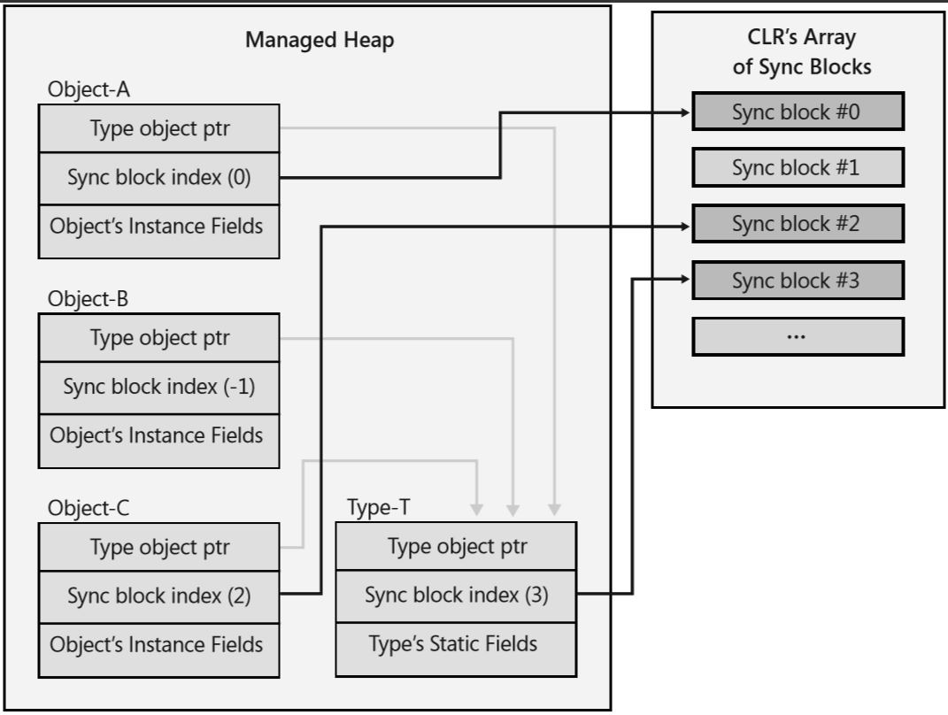
Monitor and Sync blocks
When an object is constructed, the object’s sync block index is initialized to -1, which indicates that it doesn’t refer to any sync block.
When Monitor.Enter is called, the CLR finds a free sync block in the array and sets the object’s sync block index to refer to the sync block that was found.
When Exit is called, it checks to see if there are any more threads waiting to use the object’s sync block. If there are no threads waiting for it, the sync block is free, Exit sets the object’s sync block index back to -1, and the free sync block can be associated with another object in the future.
Demo: Transaction class.

Slide 7
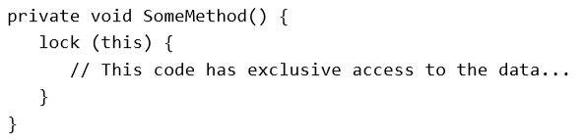
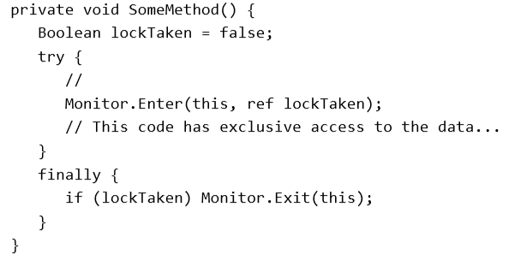
C# Sync keyword
C# has a special keyword which is transformed to a Monitor implementation.
The recommendation is not to
use C#’s lock statement.
Notes:
If an exception occurs inside the try block while changing state, then the state is now corrupted. When the lock is exited in the finally block, another thread will now start manipulating the corrupted state. It is better to have your application hang than it is to continue running with a corrupted state and potential security holes.
The second problem is that entering and leaving a try block decreases the performance of the method.

Slide 8
The ReaderWriterLockSlim Class
If this data is protected by a mutual exclusive lock (like the SimpleSpinLock, SimpleWaitLock, SimpleHybridLock, AnotherHybridLock, SpinLock, Mutex, or Monitor), then if multiple threads attempt this access concurrently, only one thread gets to run and all the other threads are blocked.
However, if all the threads want to access the data in a read-only fashion, then there is no need to block them at all; they should all be able to access the data concurrently.
ReaderWriterLockSlim construct encapsulates the logic to solve this problem. Specifically, the construct controls threads like this:
When one thread is writing to the data, all other threads requesting access are blocked.
When one thread is reading from the data, other threads requesting read access are allowed to continue executing, but threads requesting write access are blocked.
When a thread writing to the data has completed, either a single writer thread is unblocked so it can access the data or all the reader threads are unblocked so that all of them can access the data concurrently. If no threads are blocked, then the lock is free and available for the next reader or writer thread that wants it.
When all threads reading from the data have completed, a single writer thread is unblocked so it can access the data. If no threads are blocked, then the lock is free and available for the next reader or writer thread that wants it.
Demo

Slide 9
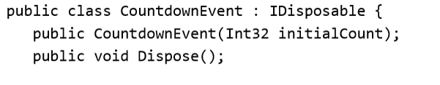
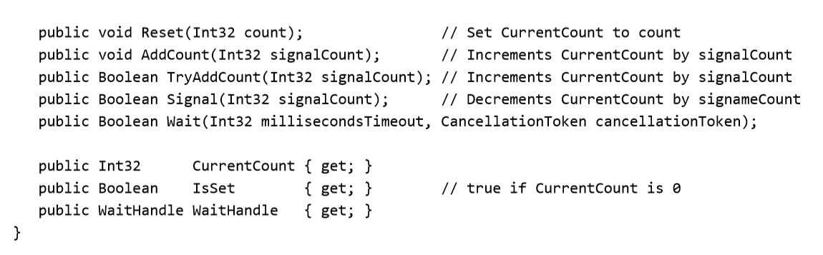
CountdownEvent Class
Internally, this construct uses a ManualResetEventSlim object. This construct blocks a thread until its internal counter reaches 0. In a way, this construct’s behavior is the opposite of that of a Semaphore
Notes:
Once a CountdownEvent’s CurrentCount reaches 0, it cannot be changed. The AddCount method throws InvalidOperationException when CurrentCount is 0, while the TryAddCount method simply returns false if CurrentCount is 0.

Slide 10
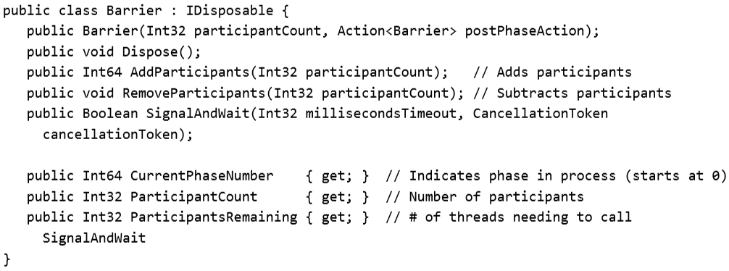
The Barrier Class
Barrier is used to control a set of threads that are working together in parallel so that they can step through phases of the algorithm together.
Example is the CLR’s GC
Notes:
Barrier blocks the thread (using a ManualResetEventSlim)

